Slide 1

Design and Development of Cutting Tool Registration Device for Micromachining Process
Mergu Vishwaja
Maroju Sreeram Rohan
BTP Supervisor: Dr. R.K.Mittal
Department of Mechanical Engineering
Indian Institute of Technology Guwahati
ME 399 BTP Phase II Presentation
2nd May 2023, IIT Guwahati, Guwahati, India

Slide 2
CONTENTS:
Introduction
Work done previous semester
Objective of our work
Results and Conclusions
Future Work

Slide 3
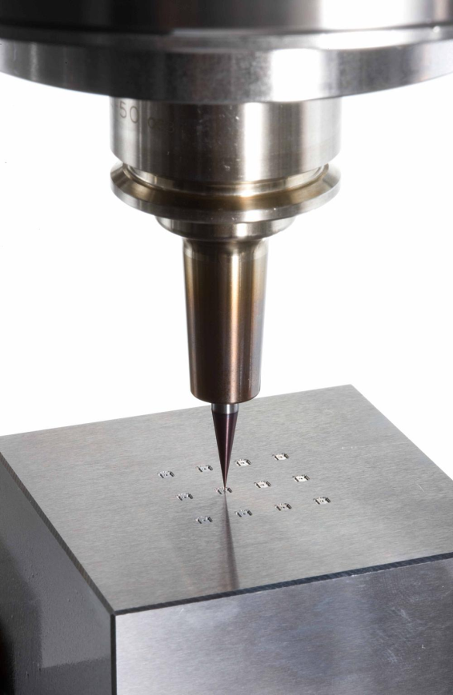
INTRODUCTION:
Our work is about design and development of cutting tool registration device for micromachining process. Micromachining allows us to make small parts and design complex geometries.Micromachining is the most basic technology for the production of such miniaturized parts and components.
We need to choose a sensor and design a fixture to fix sensor such that it detects the point when the tool touches the work piece. The force that acts on workpiece while tool touches it must be detected by sensor without causing any damage to workpiece.

Slide 4
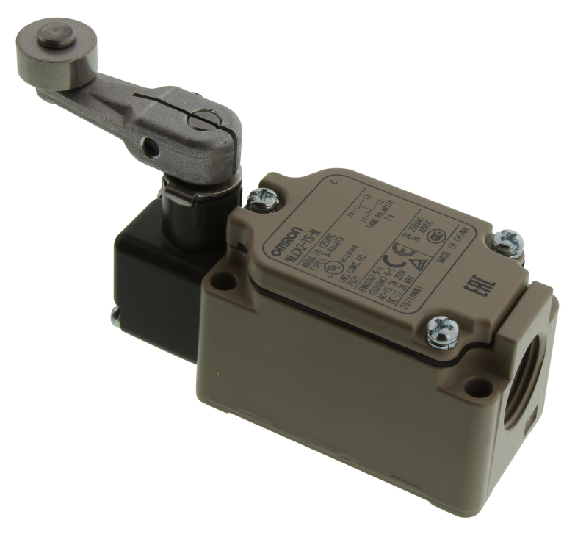
WORK DONE IN PREVIOUS SEMESTER:
We studied about different type of sensors and decided that Limit switch would be ideal for our project.
We chose Miniature Limit switch as the sensor and tried to design a fixture suitable to it.
We encountered some limitations which are associated with miniature limit switch.

Slide 5
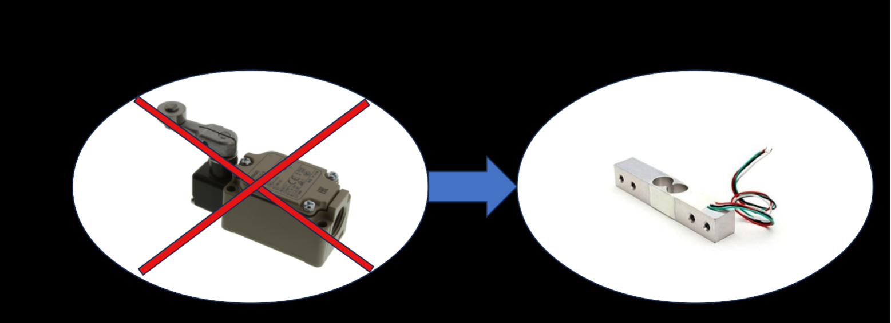
WORK DONE IN PREVIOUS SEMESTER:
Limitations:
Certain force will be already acting on the limit switch due to the weight of fixture above it. Due to this we may not get the accurate reading when the tool is touching the workpiece.
This is why we selected load cell as the sensor for our project

Slide 6
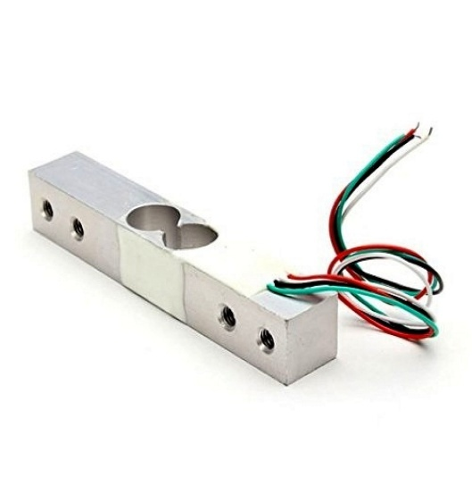
OBJECTIVE OF OUR WORK:
To find the sensivity of 1kg load cell and design a fixture suitable to it.
To find the minimum amount of force to which this load cell responds.
By this we could determine if load cell is suitable for our project or not.

Slide 7
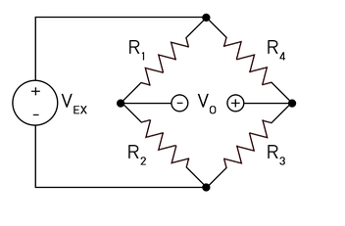
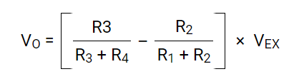
LOAD CELL:
Load cells contain strain gauges, which are thin wires or foil strips of metal that change their electrical resistance when they are stretched or compressed.
The output signal is usually in the form of a voltage which can be processed by a microcontroller, display or other electronic device for further processing and analysis.
To make these small changes into something more measurable is to interconnect them as a Wheatstone bridge.
By applying Kirchhoff's law we will get :

Slide 8
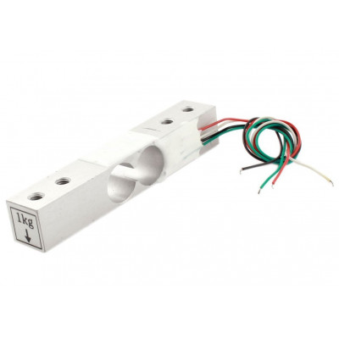
LOAD CELL:
When a force is applied to the load cell, the resistance in each strain gauge changes and VO is measured.
This is a standard load cell for measuring weight upto 1 Kg. The output of the load cell is in mili-volts and cannot be directly measured by a micro-controller.
So an ADC with high resolution or an instrumentation amplifier is required to make the output of the load cell readable to a micro-controller.

Slide 9
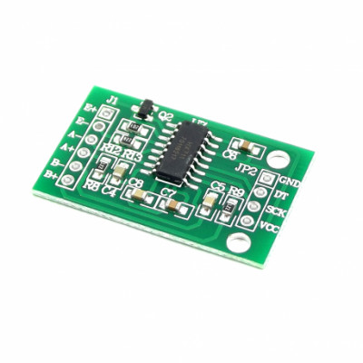
AMPLIFIER:
HX711 module is a Load Cell Amplifier breakout board for the HX711 IC that allows you to easily read load cells to measure weight.
This module uses 24 high precision A/D converter chip HX711.
It is a specially designed for the high precision electronic scale design, with two analog input channel, the internal integration of 128 times the programmable gain amplifier.
HX711 has added advantages such as high integration, fast response, immunity, and other features improving the total performance and reliability.

Slide 10
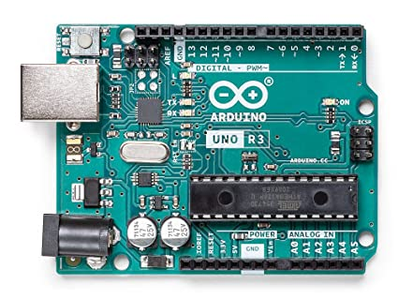
ARDUINO UNO:
Arduino Uno is one of the most popular and widely used microcontroller boards.
The digital input/output pins on the Arduino Uno can be used as either inputs or outputs, and can be controlled using software.
It can be programmed using the Arduino IDE, which is a free software tool that allows users to write and upload code to the board.
The Arduino Uno board has built-in analog-to-digital converters (ADCs) that can read the small electrical signals generated by the load cell and convert them into digital signals that can be processed by the microcontroller.
The ADCs in the Arduino Uno can sample the load cell signal at a high rate and with high precision, allowing for accurate measurement of force or weight.

Slide 11
SPECIFICATIONS:
Amplifier:
Differential input voltage: ±40mV (Full-scale differential input voltage is ± 40mV).
Data accuracy: 24 bit (24 bit A / D converter chip.)
Refresh frequency: 10/80 Hz
Operating Voltage: 2.7V to 5VDC
Operating current: <10 mA
Size: 24x16mm

Slide 12
SPECIFICATIONS:
Load Cell:
Load cell material: Aluminum
Connecting cable: ø4.2x350mm
Method of connecting wire: I/P - Red(+),Black(-) O/P - Green(+),White(-)
Input resistance(O): 402±6
Output resistance(O): 350±3
Rated output(MV/V): 2.0±0.15

Slide 13
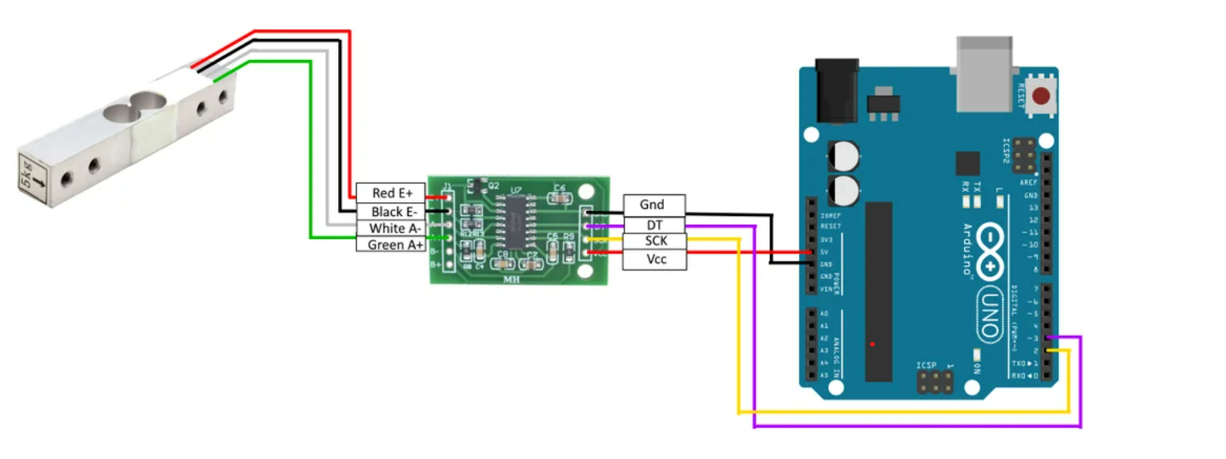
CONNECTION:

Slide 14
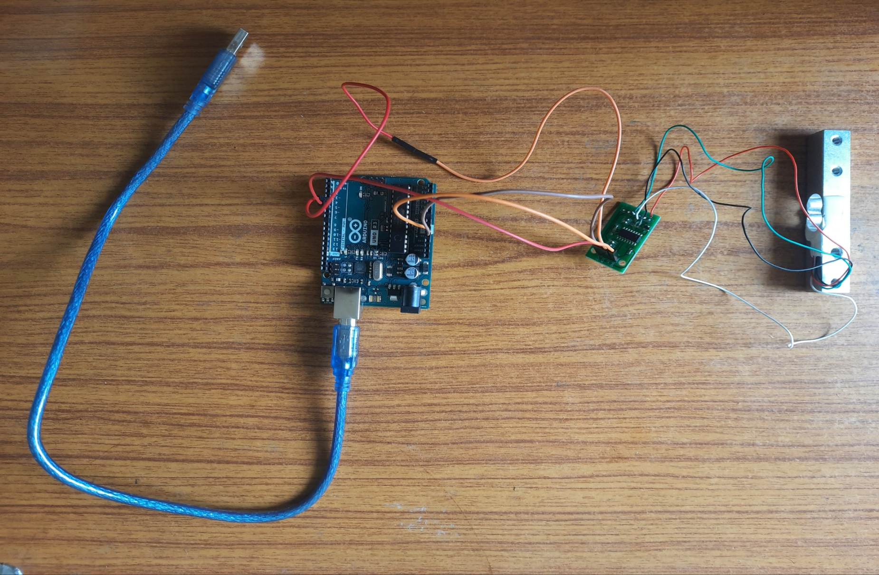
CONNECTION:

Slide 15
RESULTS AND CONCLUSIONS:
Limit switch is not suitable for our project.
We successfully made connections of load cell,amplifier and Arduino in order to show reading when force is applied on loadcell.
The reading is accurate if loadcell is fixed.
The loadcell which we chose is sensitive.

Slide 16
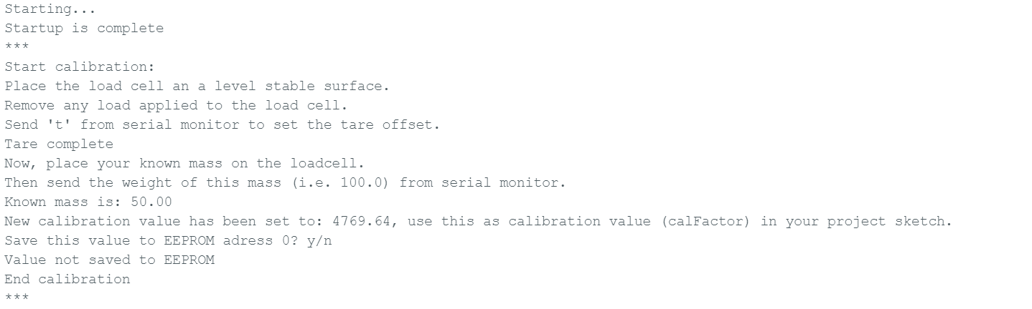
RESULTS AND CONCLUSIONS:

Slide 17
FUTURE WORK:
In order to make loadcell fixed we need to design a fixture suitable to that. So we will focus on designing fixture in coming days.
We got to know that 1kg loadcell is giving us reading in the way we wanted so, we can use loadcells which are highly sensitive like 1g loadcell for micromachining process.
We will work on invh app which is in mobile as it gives us the readings of disturbance caused around it with in built accelerometer.

Slide 18
THANK YOU

